Slide 1
A Survey on Internet of Things as Enabler for Sustainable Supply Chains
Seminar Internet of Things & Security
Marc-Andre Juritz 06.07.2022

Slide 2
Agenda
Motivation
Preliminaries
Methodology
Literature review
Solution categorization
IoTs own footprint
IoT in food manufacturing
Discussion
Conclusion

Slide 3
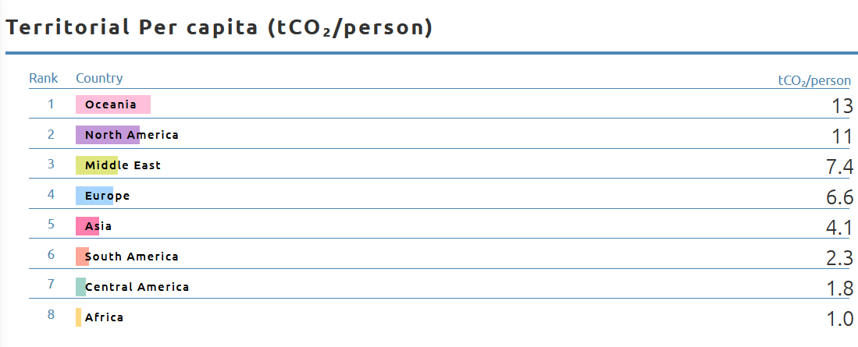
1. Motivation
Paris Agreement:
Preventing irreversible damage from man-made climate change
Upper limit of the CO2 budget that may still be emitted
Massive reduction of carbon emissions
Limitation of global warming to 1.5 degree
Supply chain challenges:
60% of global CO2 emissions generated by supply chains
companies are struggling to decarbonize their supply chains and achieve net-zero emission
Identification and evaluation of current IoT research solutions
Motivation | Preliminaries | Methodology | Literature review | Solution categorization | IoTs own footprint | IoT in food manufacturing | Discussion | Conclusion

Slide 4
2. Preliminaries
Internet of Things (IoT)
Networking of objects and machines via the Interne
Devices with unique identity
Green Internet of Things (G-IoT)
Make software and hardware more sustaibable
Integration and monitoring of supply chain sustainability
Green Supply Chain Management (GSCM)
Establishment and management of supply chains
Consideration of process from raw material to consumer
Industry 4.0
Sensors and RFID technology
Machine-2-Machine communication
Reduce emissions and optimize logistics
Improving environ- mental performance throughout the supply chain
Positive impact on the companies’ performance
Economic, social, and environmental aspects
Motivation | Preliminaries | Methodology | Literature review | Solution categorization | IoTs own footprint | IoT in food manufacturing | Discussion | Conclusion

Slide 5
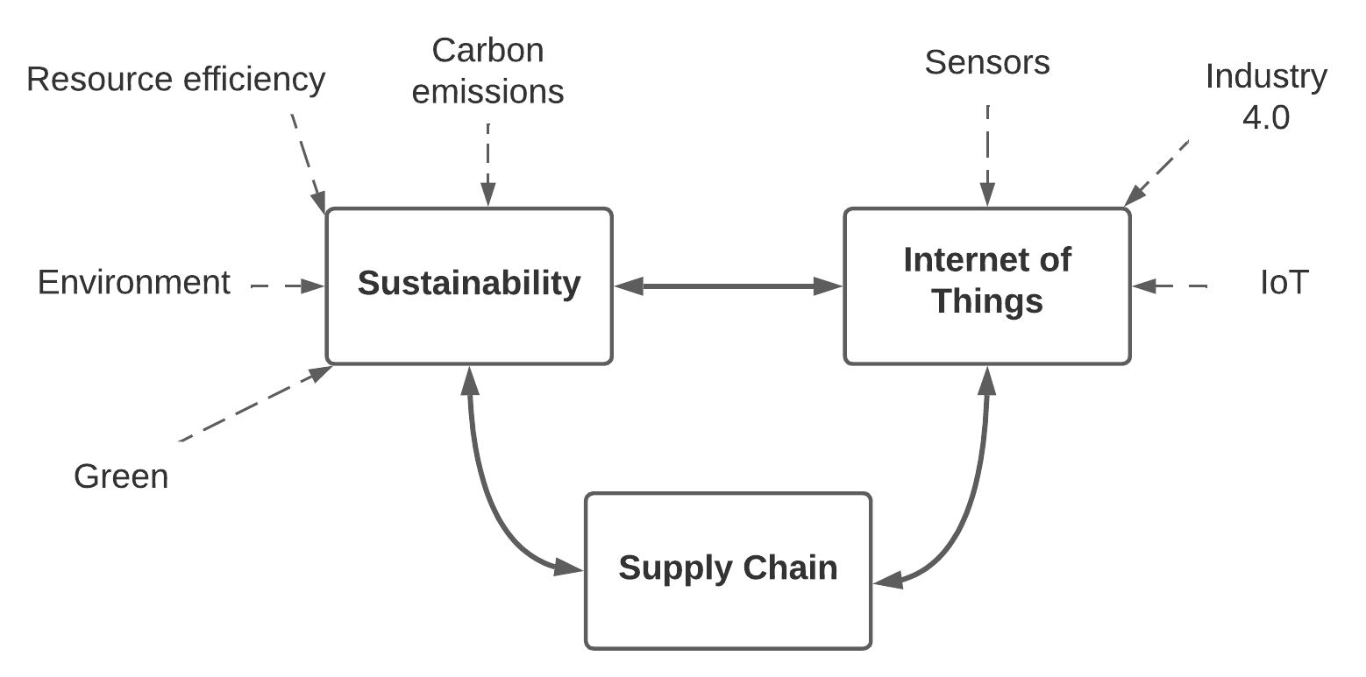
3. Methodology
Systematic literature research based on vom Brocke et al. (2009)
Initial search terms:
supply chain AND sustainability AND internet of things
supply chain AND carbon emissions AND internet of things
supply chain AND green AND internet of things
Refine of search term based on concept map & forward and backward search
Bibliometric analysis using the tool MAXQDA
Motivation | Preliminaries | Methodology | Literature review | Solution categorization | IoTs own footprint | IoT in food manufacturing | Discussion | Conclusion

Slide 6
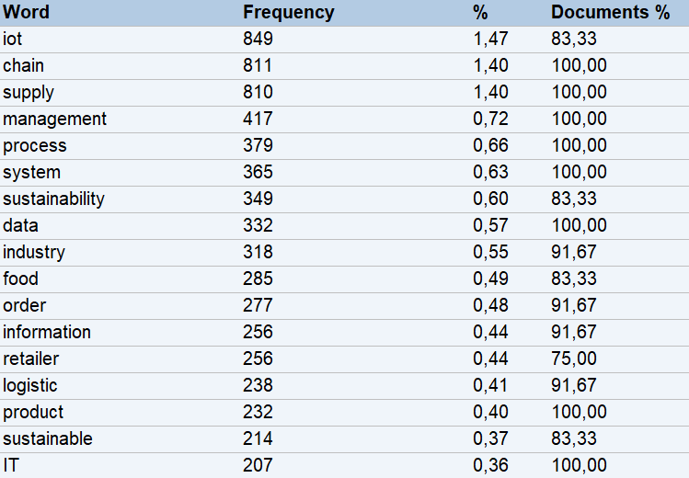
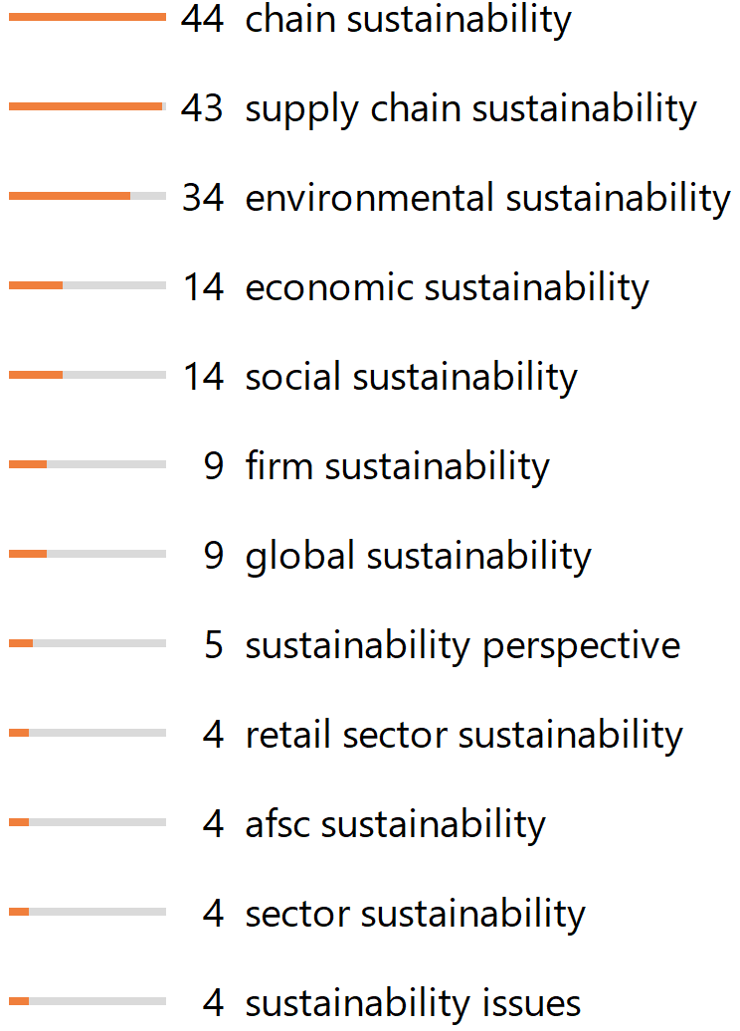
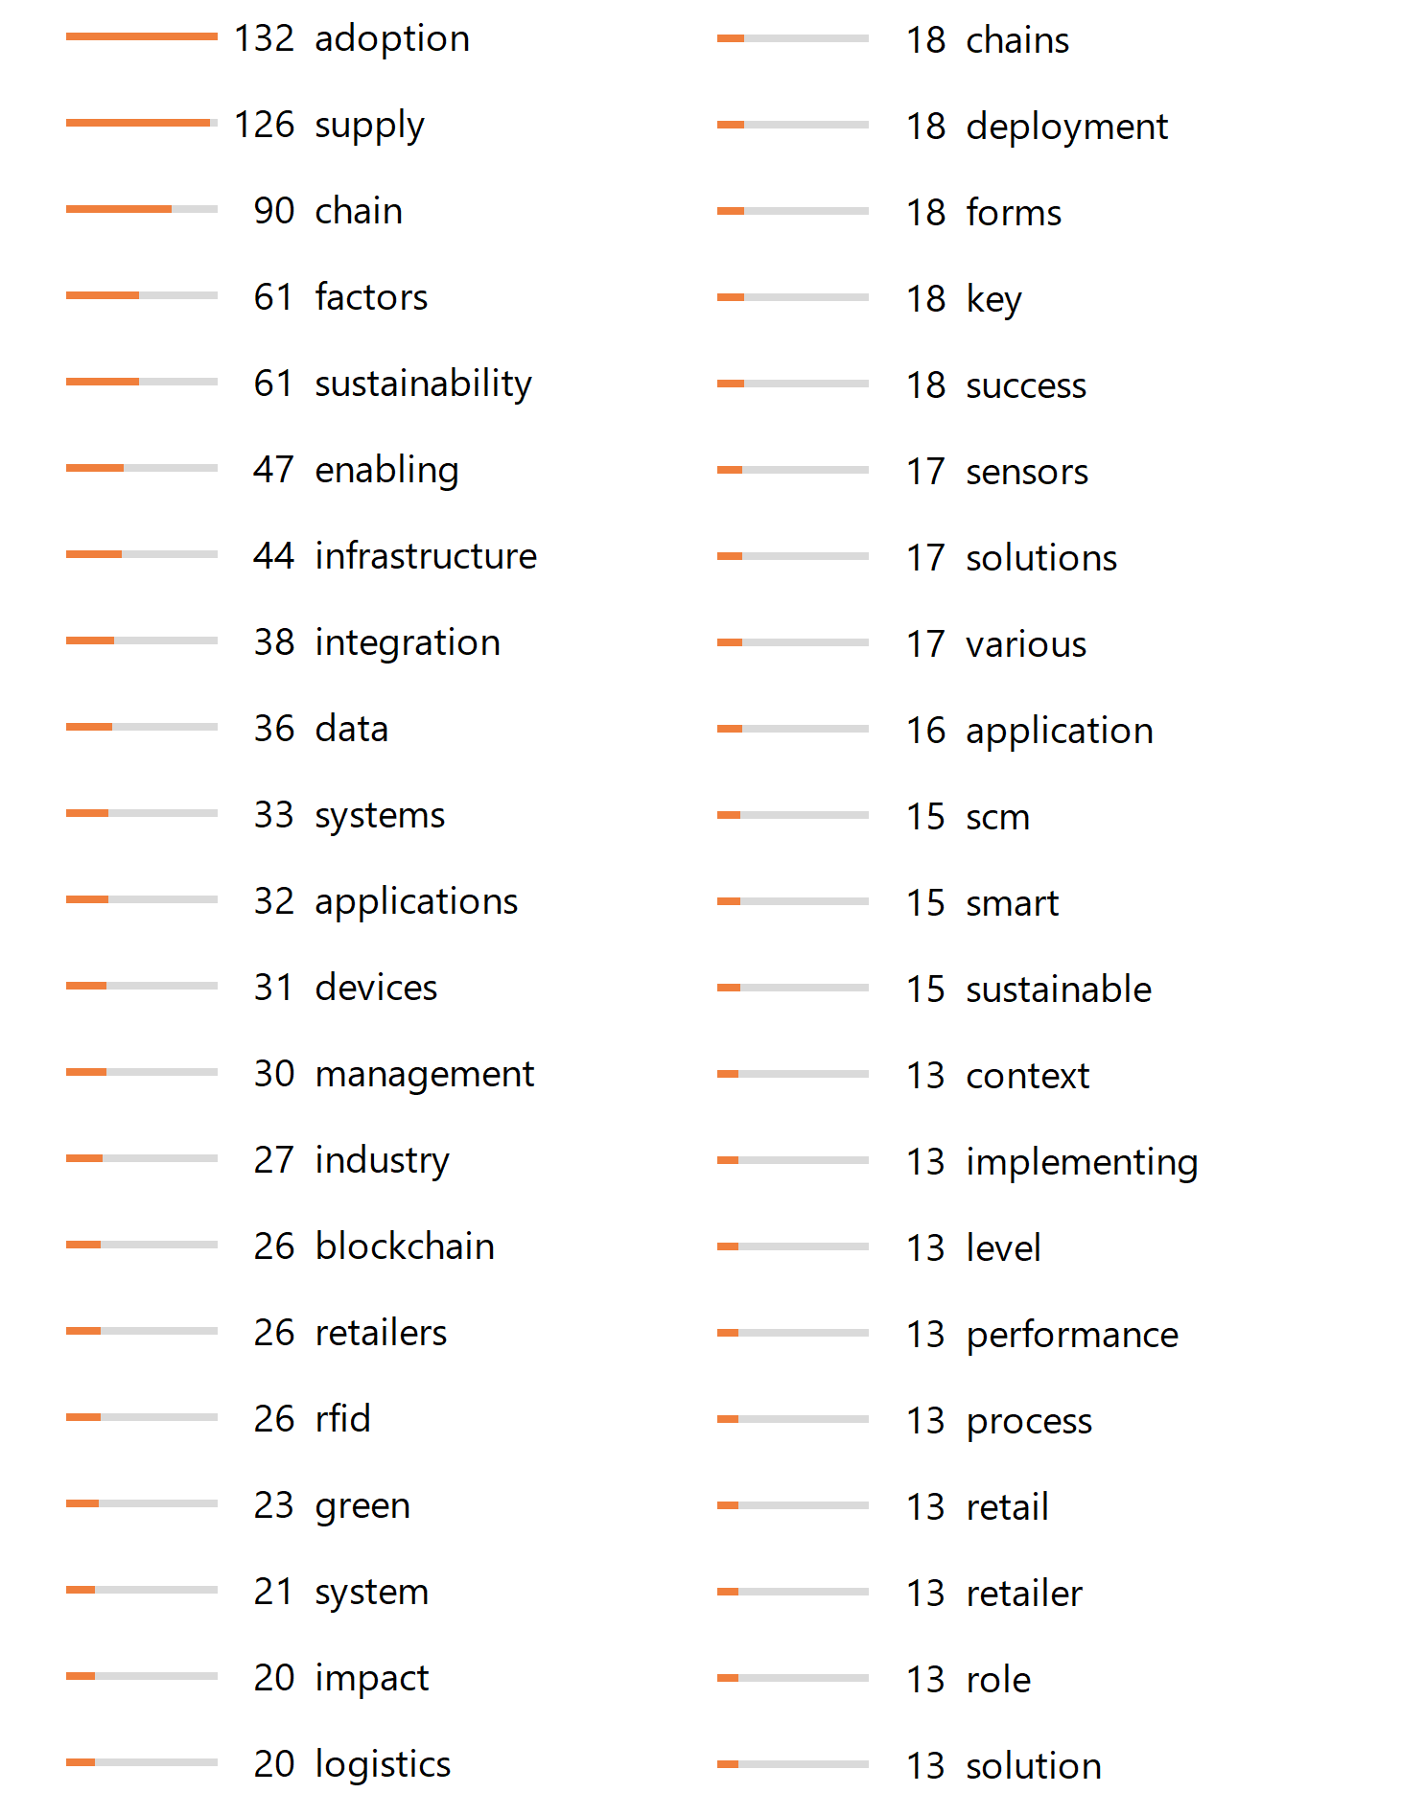
4. Literature review
Comparison of papers regarding application field, research method, IoT technology, IoT impact, outcomes
Usage of case studies with industry partners
Data collection through exploratory and empirical surveys
Frameworks and architecture solutions
Main focus: optimize usage of resources
Bibliometric analysis
Motivation | Preliminaries | Methodology | Literature review | Solution categorization | IoTs own footprint | IoT in food manufacturing | Discussion | Conclusion

Slide 7





5. Solution categorization
Routing
Networking
Virtualisation
Cloud Computing
Security and privacy
Virtualisation
Motivation | Preliminaries | Methodology | Literature review | Solution categorization | IoTs own footprint | IoT in food manufacturing | Discussion | Conclusion

Slide 8
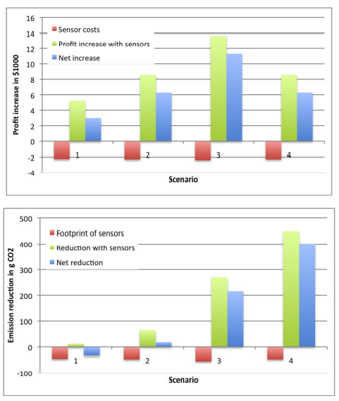
6. IoTs own footprint
According to Ilic et al. (2009):
Investigation of interaction and comparison of
Sensor cost ⬄ Profit increase
Sensor footprint ⬄ Carbon reduction
Four scenarios:
(1) Switzerland, national, 100km
(2) EU, short distance, 500km
(3) EU, long distance, 1.500km
(4) International, med. distance, 3.000km
Motivation | Preliminaries | Methodology | Literature review | Solution categorization | IoTs own footprint | IoT in food manufacturing | Discussion | Conclusion

Slide 9
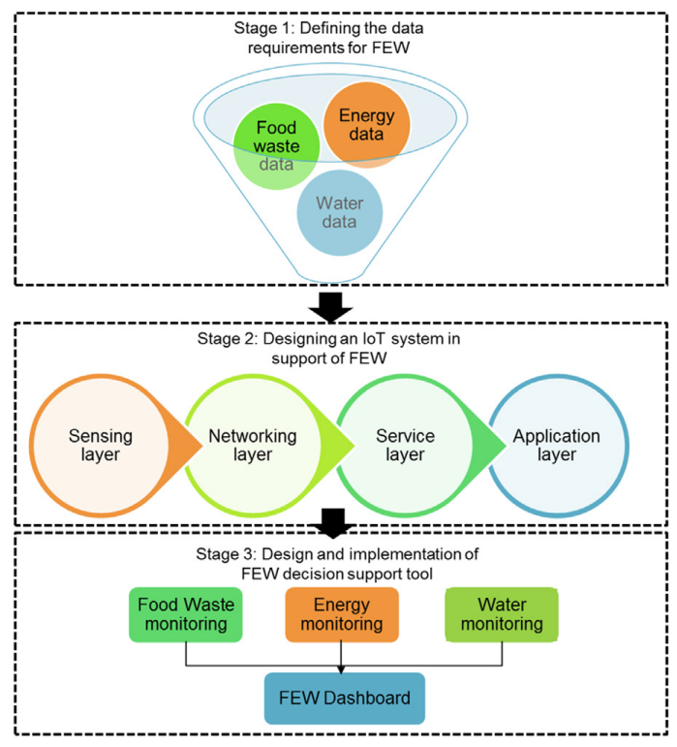
7. IoT in food manufacturing
Jagtap, Sandeep & Garcia-Garcia, Guillermo & Rahimifard, Shahin. (2021).
Optimisation of the resource efficiency of food manufacturing via the Internet of Things.
Computers in Industry. 127. 10.1016/j.compind.2021.103397.
inefficient food supply chain, large amount of food waste, volumes of water and energy used
stricter regulations on the disposal and treatment of food waste, carbon emissions and wastewater discharge
accurate real-time monitoring
→ help food manufacturers to redesign their processes
Motivation | Preliminaries | Methodology | Literature review | Solution categorization | IoTs own footprint | IoT in food manufacturing | Discussion | Conclusion

Slide 10




8. Discussion
Early stage of IoT diffusion in supply chains
→ Untapped potential
Balance between prevented and generated carbon emissions through deployment of IoT
Integration of all stakeholders in the process and no silo thinking
→ Gaining maximum advantage of IoT technology in supply chains
Overcome „never change a running system“ approach, promote digital transformation, acquisition of specialist knowledge
→ Support diffusion of IoT in supply chains
Motivation | Preliminaries | Methodology | Literature review | Solution categorization | IoTs own footprint | IoT in food manufacturing | Discussion | Conclusion

Slide 11
9. Conclusion
Paper provides an answer to the research question
What existing solutions in research are using the Internet of Things technologie in supply chains to
make them more sustainable and environmentally friendly?
Reflection of survey on current state of research on how existing solutions aim to make supply chains more sustainable with the help of IoT
Focus of sustainability question not only on the environment, but also on other aspects, such as social and economic components
Supply chains of companies in every industry are facing major changes due to the digital transformation and Industry 4.0
Use of IoT provides opportunities but also challenges for companies
Implementation of IoT in a structured and organized way, as described in the existing solutions, through frameworks or simulation studies.
Motivation | Preliminaries | Methodology | Literature review | Solution categorization | IoTs own footprint | IoT in food manufacturing | Discussion | Conclusion

Slide 12
A Survey on Internet of Things as Enabler for Sustainable Supply Chains
Seminar Internet of Things & Security
Marc-Andre Juritz 06.07.2022
Thank you for your attention. Questions? Feedback?

Slide 13
1. Motivation
Paris Agreement:
Preventing irreversible damage from man-made climate change
Upper limit of the CO2 budget that may still be emitted
Massive reduction of carbon emissions
Limitation of global warming to 1.5 degree
Supply chain monitoring:
Many unknown parameters
Scope 3 emissions hard to measure
Short-term profit maximization is often seen as more important than long-term emissions reduction
BUT: No climate protection is more expensive in the long term than introducing appropriate measures to reduce emissions

Slide 14
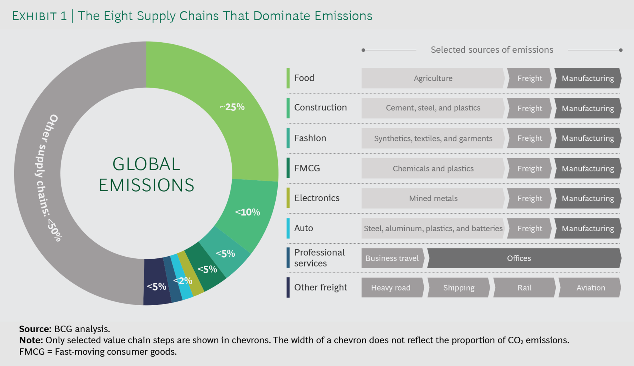

Slide 15
3. List of references („width“ coverage)
Haass, Rasmus & Dittmer, Patrick & Veigt, Marius & Lütjen, Michael. (2014). Reducing food losses and carbon emission by using autonomous control – A simulation study of the intelligent container. International Journal of Production Economics. 164. 10.1016/j.ijpe.2014.12.013.
Ilic, Alexander & Staake, Thorsten & Fleisch, Elgar. (2009). Using Sensor Information to Reduce the Carbon Footprint of Perishable Goods. Pervasive Computing, IEEE. 8. 22 - 29. 10.1109/MPRV.2009.20.
He, Miao & Ren, Changrui & Wang, Qinhua & Shao, Bing & Dong, Jin. (2010). The Internet of Things as an Enabler to Supply Chain Innovation. 326 - 331. 10.1109/ICEBE.2010.11.
Varriale, Vincenzo & Cammarano, Antonello & Michelino, Francesca & Caputo, Mauro. (2021). Sustainable Supply Chains with Blockchain, IoT and RFID: A Simulation on Order Management. Sustainability. 13. 6372. 10.3390/su13116372.
Lafferty, C.. (2019). Sustainable internet-of-things-based manufacturing systems: Industry 4.0 wireless networks, advanced digitalization, and big data-driven smart production. Economics, Management, and Financial Markets. 14. 16-22. 10.22381/EMFM14420192.
Hu, Fangjie & Zhang, Xiaoqiang & Tian, Gang. (2012). Research on Low Carbon Logistics System Based on Internet of Things. 806-812. 10.1061/9780784412602.0125.
Pimsakul, S., Samaranayake, P., & Laosirihongthong, T. (2021). Prioritizing enabling factors of IoT adoption for sustainability in supply chain management. Sustainability, 13(22). https://doi.org/10.3390/su132212890
Jagtap, Sandeep & Garcia-Garcia, Guillermo & Rahimifard, Shahin. (2021). Optimisation of the resource efficiency of food manufacturing via the Internet of Things. Computers in Industry. 127. 10.1016/j.compind.2021.103397.

Slide 16
4. Focus on a particular solution („depth“ coverage)
Jagtap, Sandeep & Garcia-Garcia, Guillermo & Rahimifard, Shahin. (2021). Optimisation of the resource efficiency of food manufacturing via the Internet of Things. Computers in Industry. 127. 10.1016/j.compind.2021.103397.
inefficient food supply chain, large amount of food waste, volumes of water and energy used
stricter regulations on the disposal and treatment of food waste, carbon emissions and wastewater discharge
accurate real-time monitoring → help food manufacturers to redesign their processes
Paper presents: IoT-based framework for monitoring the generation of food waste and the use of energy and water in the food sector

